Slide 1

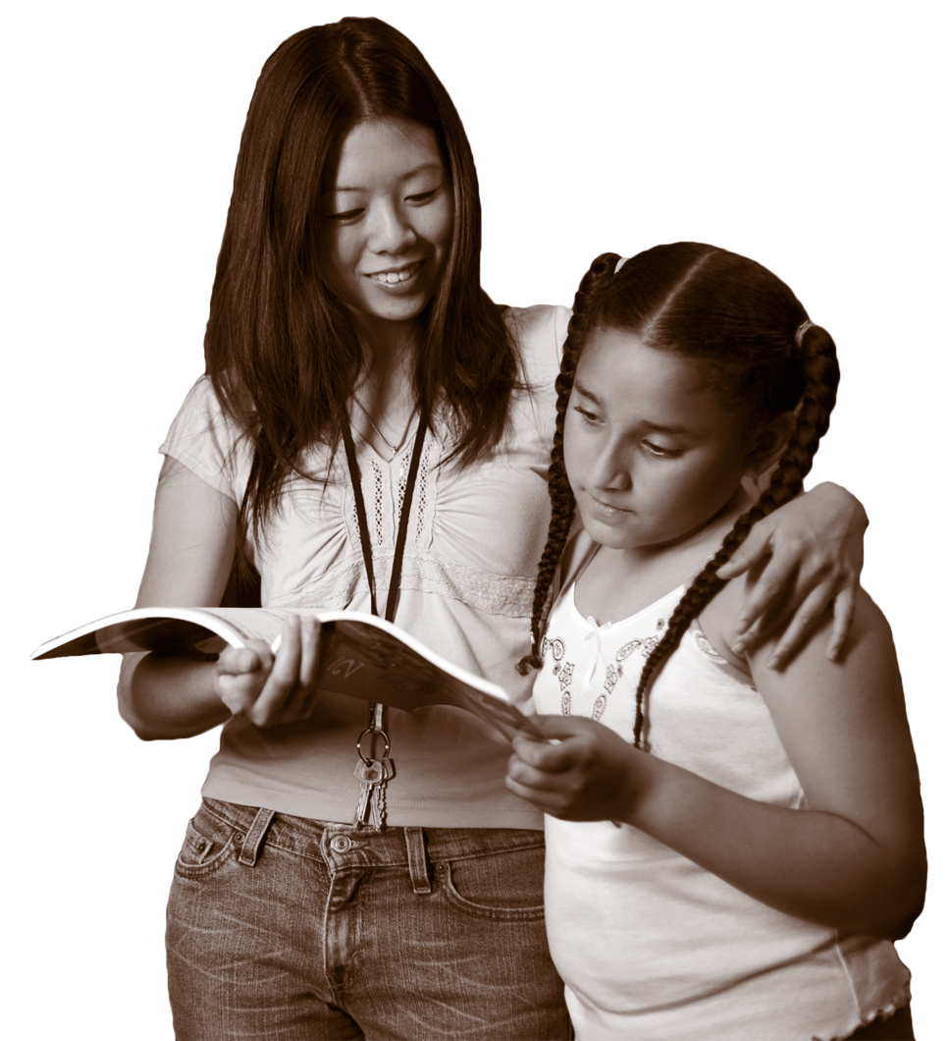

CENTER FOR STRENGTHENING THE TEACHING PROFESSION • 253-752-2082 • www.cstp-wa.org
Closing the Achievement Gap
Culturally Responsive
These materials funded by the Grousemont Foundation.

Slide 2
Closing the Achievement Gap
If nothing changes, it is estimated that Washington will close its opportunity gaps by the following years:
Black Hispanic American Indian
4th Grade Reading 2022 (12 yrs) 2022 (12 yrs) 2029 (19 yrs)
4th Grade Math 2042 (32 yrs) 2050 (40 yrs) 2049 (39 yrs)
10th Grade Reading 2017 (7 yrs) 2017 (7 yrs) 2018 (8 yrs)
10th Grade Math 2064 (54 yrs) 2056 (46 yrs) 2058 (48 yrs)
Source: OSPI research

Slide 3
Changing Demographics in Washington State
This table is part of OSPI’s Achievement Gap Oversight and Accountability Committee report from January 2010.
The white student population in Washington’s public education system has declined, while the population of students of color has increased by 38%.
 | 1998-99 | 2009-10 | Growth
All Students | 999,616 | 1,040,750 | 4.1%
White | 759,708 | 672,350 | -11.5%
Latino | 90,965 | 158,612 | 74.4%
Asian Amer./Pac. Islander | 70,973 | 89,231 | 25.7%
African American | 50,980 | 56,790 | 11.4%
Amer. Ind./Alaska Native | 27,989 | 27,363 | -2.2%
Bilingual/ELL | 50,980 | 83,260 | 63.3%
http://www.k12.wa.us/Cisl/pubdocs/AgapLegReport2010.pdf

