Slide 1

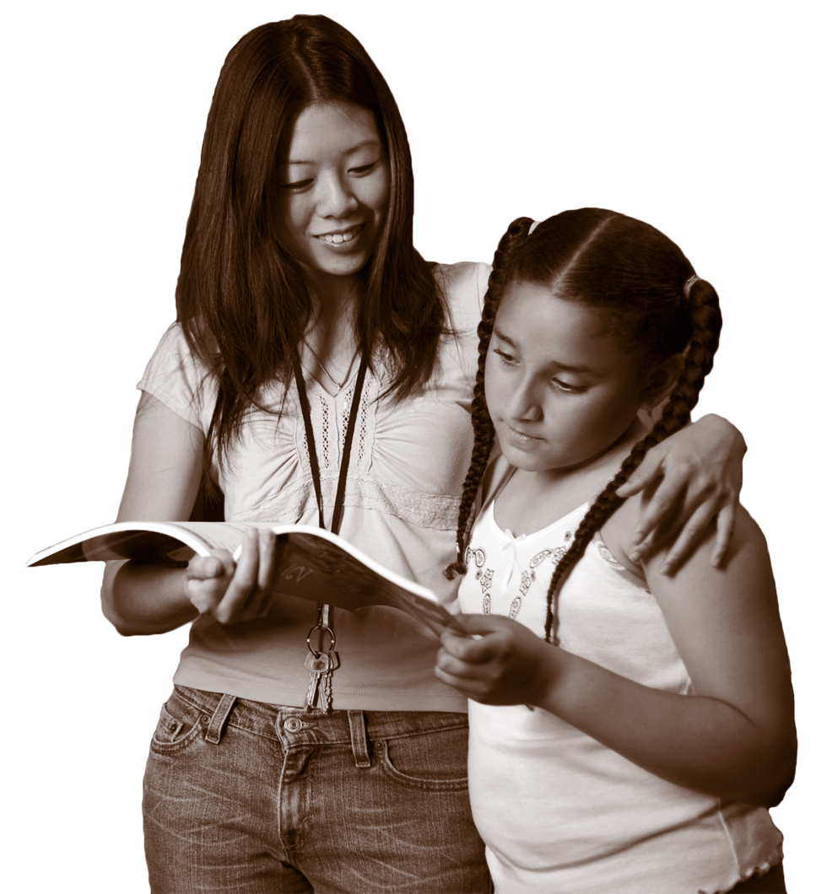

CENTER FOR STRENGTHENING THE TEACHING PROFESSION • 253-752-2082 • www.cstp-wa.org
The “New Normal”: Simultaneous Bilingualism
Kathy Escamilla, Ph.D.
University of Colorado, Boulder
WABE 2010
These materials funded by the Grousemont Foundation.

Slide 2

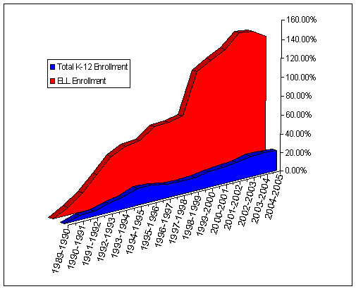
How has the ELL population changed in recent years?
Relative growth of ELL’s in U.S. schools, 1989-1990 to 2004-2005*
* SOURCE: U.S. Department of Education's survey of the states' limited English proficient students and available educational programs and services, 1991-92 through 2001-2002 summary reports. Supplemented by state publications (1998-99 data), enrollment totals from the National Center for Education Statistics (NCES), 2004-2005 Consolidated State Performance Reports, and data reported by states.

Slide 3
What we know…
The fastest growing school aged population are ELLs
We need to change this term to EBs
They have grown 160% nationally from 1990-2005
The overall K-12 population has only grown by 20%

Slide 4
What we should keep in mind…
Growth in EBs is the REASON:
That more schools aren’t closing;
That teachers aren’t losing their jobs; and
That money is flowing into the GENERAL fund of many of our local school districts.
EBs are VALUE added to our local schools and districts.

Slide 5
What we know….
EBs are heavily concentrated in various ways:
75% are concentrated in grades K-4
Within school districts individual schools
are highly segregated
EBs are concentrated linguistically
(85% speak Spanish)
95% of the linguistic diversity is accounted
for by 5 languages
(Spanish, Vietnamese, Chinese, Korean, Hmong)
67% of all EB children are U.S. born!!
They are U.S. Citizens!!!!

Slide 6
The ‘New Normal’
The more diverse our nation, the more schizophrenic
we are about diversity;
The more diverse our states, the more restrictive the educational policies;
The more diverse our schools, the more monolingual and monocultural the curriculum;
The more diverse our schools, the more we rely on conventional wisdom rather than research.

Slide 7
The ‘New Normal’
U.S. born bilinguals
‘Simultaneous bilinguals’
Children who have been exposed to two or more languages since birth and before age 5
Most of our programs are based on sequential theories
of bilingualism
Semilingual/Non-non
If they have no language, we should just teach them English

Slide 8
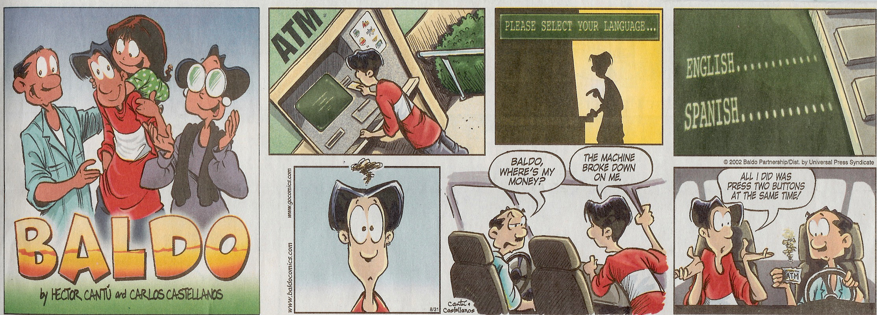

Slide 9
Normal behavior BUT bad judgments
Cross-language processing
Interlanguage or interference
Language Shift
Code-switching
Notes:
I would like to talk about in the next few minutes what are now believed to be very normal bilingual behaviors for which we make very bad judgments when it comes to educating them.

Slide 10
Cross-language processing
Thinking in L1 and Producing in L2
Happens with BOTH simultaneous and sequential bilinguals
Processing in one’s L2 is slower than in one’s native stronger language
This is seen as evidence that children are ‘slow’ when in fact they are doing cross-language processing

Slide 11
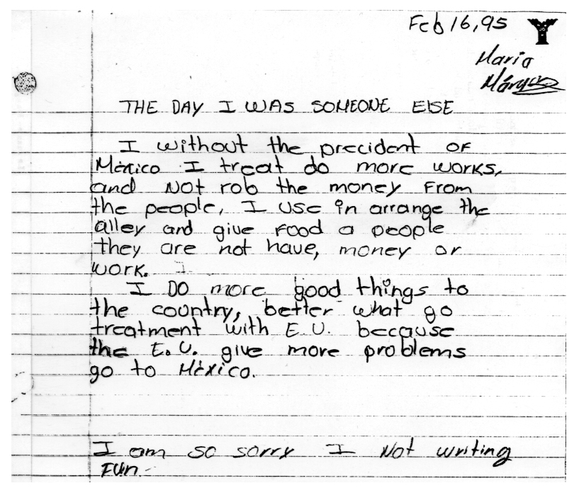

Slide 12
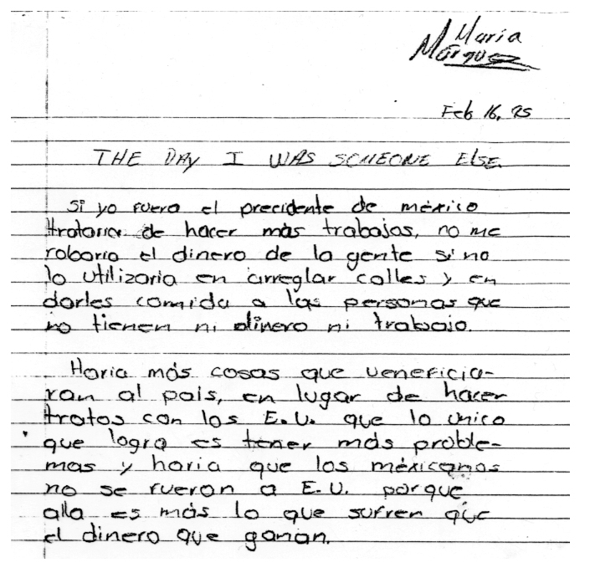

Slide 13
Interference
Occurs in 2nd language acquisition when vocabulary or syntax patterns from a learner’s first language cause errors in second language performance. The term is used largely in the United States and decreasingly in the rest of the world because of its negative and derogatory connotations (Encyclopedia of Bilingualism).

Slide 14
Interlanguage
Interlanguage
An intermediate form of language used by second language learners in the process of learning a language. Interlanguage contains some transfers of borrowing from the first language, and is an approximate system with regard to grammar and communicating meaning. (Encyclopedia of Bilingualism).
Interlanguage = L1 is a Scaffold
Interference = L1 is a Barrier

Slide 15
Interference or Interlangauge?
Este es red, ¿verdad teacher?
Kimberly está es eskipeando.
Guardé mi game boy en mi cubby.
Let’s go. Vámonos

Slide 16
A New Analysis
Interference
Tex-Mex
No clear L1 dominance
Semilingual
Spanglish
Cross-language confusion
Interlanguage
Language is learned
in context
Overgeneralization
of grammar is normal
Some things
can’t be translated
Added emphasis

Slide 17
Intereference in Action
José knows 3 colors in Spanish and 3 in English
(same 3.) He is labeled ‘limited’ in L1 and L2.
Bill know 5 colors all in English.
He is labeled as ‘average.’
Who knows more?
We need a POSITIVE interpretation about
code-switching.

Slide 18
Interference or Interlanguage?
Read the story below. What would teachers at your school say about this child’s writing?
My story is about of tree piks and 1 lobo feroz.
The lobo tiro dawn the house of paja. Den the
little pik go roning to the huse of jis brotter a
sai guat japen to the house.

Slide 19
Deficits or Strategies
Spanish Phonics
Spanish Syntax
Lexical code-switches
Piks for pigs
Jis for his
Guat for what
The house of paja -The straw house
Lobo for wolf
Paja for straw
Feroz for ferocious

Slide 20
My feibret buck..
My feibret buck is the thrie letle bers. Do you hab e feibret buck? Well I do. My feibrt buck starts wet a litle groal and shi went to de wuds….

Slide 21
My Feibret Buck
Common to Grade
Letle and various spellings of little
Bers and various spellings of bears
Wet for with
Wuds for woods
L1 influenced
E = A (Spanish)
Shi = I for E
B for V = Feibret
B for V = hab for have
(Escamilla, Geisler, Hopwell, Ruiz, 2006)
Notes:
50% of spelling errors in this study of 150 children in TBE programs – grades k-3 could be accounted for by errors that are common to grade level – the other 50% are L1 influenced but I did not say L1 interference. Issue that we need to face is that Ebs’ writing may contain common errors PLUS L1 influenced and the combination makes the children look more limited as writers than they probably are.

Slide 22
Your Turn
Read the child’s story on the next page
Identify 1 or 2 errors that are L1 influenced
Do the same for ‘common’ to grade level
Note that if you do not know something about second language learners you may have a
difficult time
Who is reading writing samples on high stakes tests?

Slide 23
The Best Thing That Ever Happened to Me
May best its wen I went ta Masapplan becas ders a oshen and Hoteles and ders a mauten dut its cald du mauten of a debl and wal you go tu massapplan ders a brell that its cold du brin of da debl and ders fishig and sharcs in the oshin and it’s a bich and a fan bich and a latf pepol and in a da oshen.
Notes:
Read this child’s story (3rd grade) – find 1-2 errors that could be attributed to L1 influence and 1 or 2 that represent ‘common’ to grade level – NOTE that the ideas are GREAT IF you can read them – NEED for teachers who know something about L2 to be reading and interpreting writing samples.
Common = becas, wen, debl, b and d reversal
L1 = hyposegmentation (latf (lot of). Tu – to, hoteles

Slide 24
Language Shift
Language shift - A change from the use of one language to another language within an individual or a language community. Language shift in minority language groups usually means language loss. (Encyclopedia of Bilingualism)
80% of ELLs will have lost their productive ability in their L1 by high school.
What’s the big deal?

Slide 25
Silva (1989)
Studies gender agreement in Puerto Rican children ages 4-7 (same children) in Chicago
Gender agreement is important in Spanish,
not in English
N=237

Slide 26
Results
At age 4 children had gender agreement (el libro, la rana, los muchachos, el agua, la mano)
At age 7, same children were losing their ability to do gender agreement and were masculinizing all nouns (el maestra, el niña)
At age 4 on the assessment children were labeled at ‘normally developing’ in Spanish
By age 7, the SAME children were labeled as language delayed

Slide 27
Simultaneous Bilingual Children in U.S.
Are frequently judged as being limited in both languages
Formal assessments that do not consider how two languages interact ‘confirm’ notion of limits in two languages
Without support in L1, language shift happens beginning at age 4

Slide 28
Preventing Language Loss
Parents should be encouraged to continue to ‘parent’ in their native language.
Parents should be encouraged to continue to speak their L1 with their children and DEMAND that their children respond back to them in L1.
Schools should have books in classrooms and libraries in a variety of L1 languages and students should be encouraged to read them.
Teachers should allow students to use L1 as a processing language.
Have an English hour at home to practice English but do not quit using L1.
Notes:
Even in programs without L1 support!

Slide 29
Code-switching
Code-switching is the use of two languages within and across sentences, phrases or thoughts.
“Attitudes about code-switching depend on WHO does the code-switching and NOT what the code-switcher does or does not know about language” (Fisher, 1972)

Slide 30
Code-switching Attitudes
Positive
if you are a majority language speaker.
“It is so bourgeois it go to a McDonald’s in Italy.”
“Yo quiero Taco Bell.”
“Steven Segal is sooooo macho.”
Negative
if you are a minority language speaker learning the majority language
“Me cantaron Happy Birthday to You.”
“My best day is wen I hav a respuesta perfect.”
“A mi me gustó cuando fuimos a el field trip.”

Slide 31
Simultaneous Bilinguals Synthesize their Two Worlds
“The wider society tries to keep children’s worlds separate, with different codes for each context. Children, however, tend to synthesize their resources. Further, the availability of alternatives is a key aspect of growing up bilingual.”
(Kenner, 2004, p. 59)

Slide 32
Simultaneous Worlds
La principal a veces te dice hola, cómo estás o
hi how are you?
[The principal sometimes says ‘hola, cómo estás’ or ‘hi, how are you.’]
Lo tercero que aprendí es no bullying.
[The third thing I learned was no bullying.]
Salimos afuera y jugamos tag.
[We went outside and played tag.]
Jugamos roc, peiper, zisors.
(We played rock, paper, scissors).
Notes:
2007 – studied code-switching behaviors in the writing of 200 children 1st- 3rd grade and we found that while code-switching was very prominent in their oral discourse – even when they were talking about what they were going to write, it rarely occurred in their writing UNLESS they were write in one language about something they had experienced in a different language (see above examples).

Slide 33
Implications
The biggest ‘problems’ with regard to code-switching among emerging bilingual/biliterate children may
have more to do with, our attitudes, the way we interpret children’s code-switches, and our desire to ‘fix’ the behavior than with what the children are actually doing.

Slide 34
A New View
Simultaneous bilinguals use Spanish (and other languages) to get to English in cognitively appropriate but misunderstood ways

Slide 35
Examples (from research)
Letter Knowledge
    Letra S, sonido s-s-s-s, como Superman
    La P como pájaro
    Q como Q tips
Writing
    Yo sé escribir mamá (mom); Te quiero (I love you)
    Tú (2)

Slide 36
Read these words
Coras
Jon
Iesipaynay
Veibies
Lecktura
Hielo house
No budi lik Tim he hab big blud

Slide 37
BUZZ
Two minutes:
1 thing I learned so far I would share at my school
1 question I still have

Slide 38
‘New’ Methods and Why They Won’t Meet the Needs of the ‘New Normal’
Intensification to catch them up – Less or no L1
Monolingual reading theories and bilingual students
‘Good teaching is good teaching’ rhetoric
The ESL quick fix diet
The privileging of ‘academic English’
The acceptance of institutional racism –
‘That’s just the way it is’

Slide 39
What About Research?
Goldenberg, C. (2008). Teaching English Language Learners: What the Research Does – and Does Not – Say. American Educator, 8-44.
Genesee, F., Lindholm-Leary, K., Saunders, W. & Christian, D. (2006). Educating English-Learners. New York: Cambridge University Press.
August, D. & Shanahan, T. (ed.) (2006). Developing Literacy in Second-Language Learners: Report of the National Literacy Panel on Language-Minority Children and Youth. Mahwah, NJ: Lawrence Erlbaum.
Notes:
What we did not have in 1969 was a research base that told was what to do - we had plenty of stats that told us we were failing second language learners, particularly those who spoke Spanish - for example in 1970 Anderson & Boyer released a report to the federal government saying that the average school completion rate for Mexican-Americans in Texas was the FOURTH grade - that was 1969 - in 2009 we have many of these same children dropping out of high school and reading at a 4th grade level. HOWEVER, what we had in 1969 was a good idea about using native languages and cultures to teach Spanish speaking children but we did not have a research base - in 2009 we have quite a good research base that no one wants to know about.

Slide 40
Intensification and Troubling Trends (Berliner & Biddle, 2004)
  Perception that EB children are problems to be ‘fixed’ has
  led to policies that intensify school programs rather than reforming them;
  Intensification curriculum = Fix kids by ‘catching them up’
  Intensification = more English (earlier), more homework, more reading and math;
  Intensification = less PE, less music, less art
  In some cases = NO RECESS
  Intensification = LESS SPANISH or other L1
  Intensification = MORE PRESSURE to teach only in English

Slide 41
What the Research Says:
Bilingual Reading Instruction (Goldenberg, 2008)
If you are doing it, keep doing it – it is a scientifically based ‘best practice’
However, effects are cumulative – 5 yrs of instruction in first language is more beneficial than 1
Key is that first language reading is beneficial to READING IN ENGLISH
Especially true for Spanish and other languages that share an alphabetic principle with English
Cross-language transfer needs to be explicitly taught
Moot point as few children have this opportunity
Notes:
The last slide is probably the most pertinent and yet I had to tell you!

Slide 42
Goldenberg (cont.)
Using a child’s native language can enhance learning even if it is not used as a medium of instruction.
For example, clarifying information and concepts, classroom management, communicating with parents, cognates, and in encouraging bilingualism.
Bilingualism is a cultural, intellectual, cognitive, vocational and economic advantage.
Banning or forbidding children to use their native languages in schools is counter-productive and does NOT accelerate English acquisition.
INTENSIFICATION IS NOT A BEST PRACTICE!!!!!!
FIGURE OUT HOW TO USE BOTH LANGUAGES!
Notes:
What if we can’t do bilingual reading programs?
The research is pretty clear and again many of our school districts look like 1969 when we acted our of ignorance - in 2009 we can only say the research is on our side -

Slide 43
Monolingual Reading Theory
Berhardt, 2003; Grant & Wong, 2003; Halcón, 2001
Universalist view (L1 and L2 reading development are
the same)
North American/British/Australian literacy industry drives education policy
Research on literacy teaching and development predominately done by monolingual English speakers on monolingual English children
Treatment of all ELLs as if they were the same (English/Spanish; Farsi/English) (L1 is not irrelevant)
Exacerbated in the last decade by high stakes tests developed for monolingual English students

Slide 44
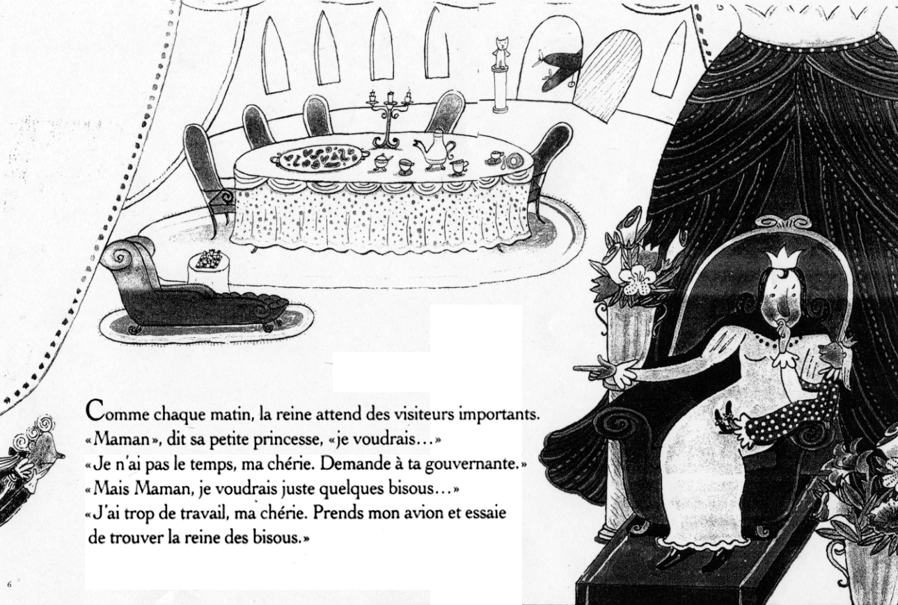
Notes:
Please read this story – turn and talk to a neighbor about the main idea in the story – did you use English???? Please use French!!

Slide 45
Beyond “good teaching” platitudes
Read it to yourself, Read it out loud, Ask yourself - “Does this make sense?”
Good strategy in L1 - Not in L2
Turn to a partner - talk about the story, -
Good Strategy L1 not L2 UNLESS
You use L1 strategically –
what language did you use to talk to you partner?

Slide 46
Read This…..Repeat Strategy
The handsome young prince walked in the forest one bright summer day. She got tired and stood under a tree to keep from getting wet.

Slide 47
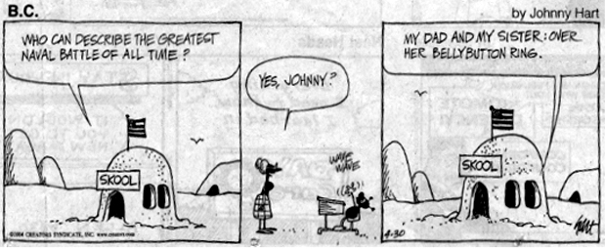
Notes:
Reading comprehension has to do with cultural schema not just language

Slide 48
Beyond ‘Good Teaching’:
Background Knowledge ≠ Cultural Schema
Background knowledge:
Johnny jokes
Double meaning of the word naval - branch of the military; your belly button
Cultural Schema
Piercing your belly button is not a taboo in some cultures;
Children do not challenge the authority of their parents –
there are not battles

Slide 49
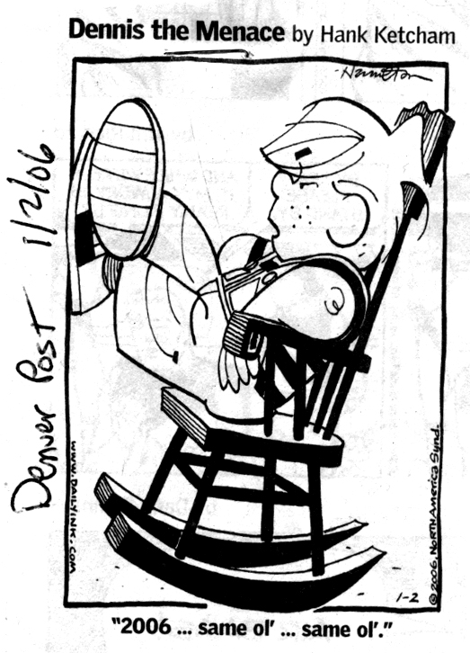
Notes:
What do you need to know culturally and linguistically???

Slide 50
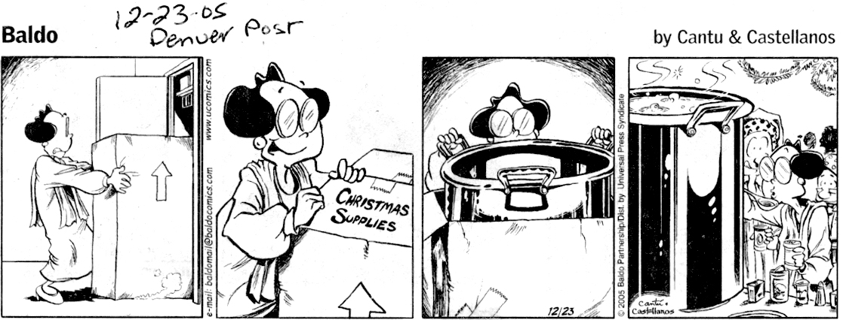
Notes:
Tamales, ponche, pozole, LOOK at the word Chrismas Supplies – what does it mean in the dominant culture?

Slide 51
Fix the program, engage the kid!
Good teaching for ELLs is DIFFERENT
Vocabulary (8-10 words NOT 20)
Oracy structures (dialogue, rehearse structures, enrich vocabulary
Focus on language arts as well as content
Analyze text and material for cultural content as well as background knowledge

Slide 52
Learning to read for a child
with two languages is DIFFERENT!
Moll & Diaz (1987)
Do NOT take away scaffold
Allow extra time to process
Reading comprehension has two facets (understanding and production) - L2 students may comprehend MORE than they can produce causing us to think they are performing at lower levels than they are
With new material - allow students to read it in L2, process in L1 (with peers), then produce it in L2

Slide 53
Goldenberg (2008) SOME of what we know about good teaching is also true for EBs
‘Good teaching is good teaching’
Predictable and consistent classroom routines;
Well-designed, clearly structured and APPROPRIATELY PACED instruction;
Active engagement and participation;
Opportunities to practice, apply and transfer new learning;
Feed-back on correct and incorrect responses;
Frequent and periodic assessment of progress
Feeling that they belong to a classroom and school community.
NONE of these findings relate to language and literacy instruction
Notes:
The people who love the ‘good teaching is good teaching’ platitudes will like this
However in schools where the program is pull-out ESL, much of the above is likely NOT to be true

Slide 54
However……
There are many ways that hiding behind the ‘good teaching is good teaching’ rhetoric limits our understanding of Ebs
See for example Manuel’s writing…

Slide 55
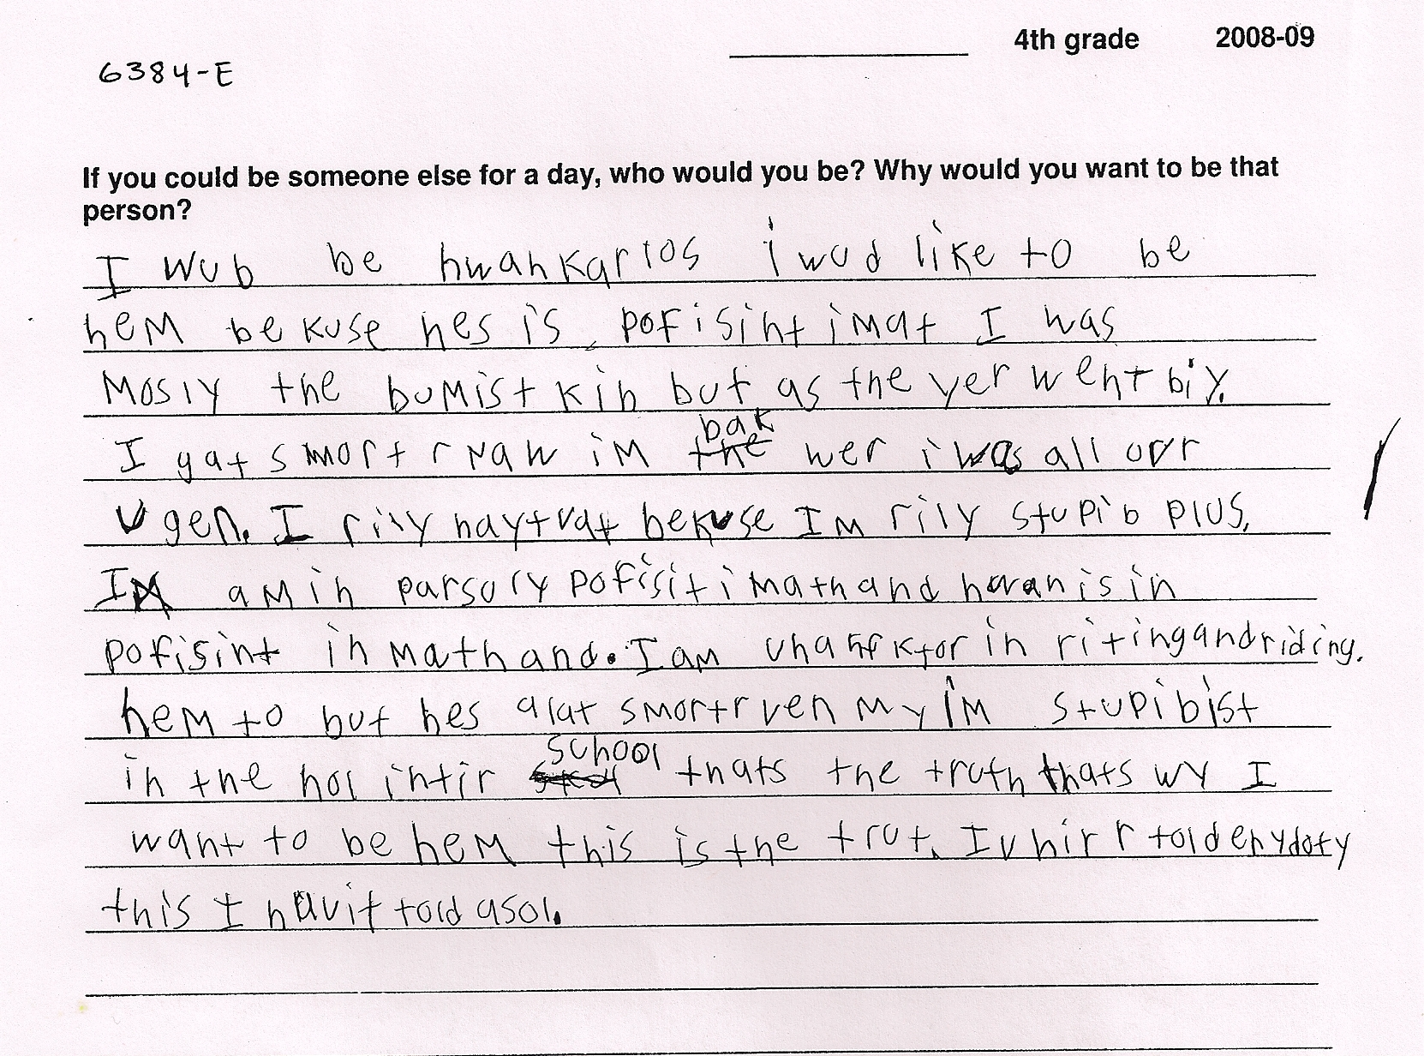
Manuel: Unreadable……
Notes:
Manuel is in a school that is participating in Literacy Squared® research project. Literacy squared in a bilingual intervention, 5 year longitudinal study - data are collected on all children in Span and English - the writing sample was gathered via a writing prompt - “If you could be someone else for a day who would you be? Why would you want to be that person?” Manuel has been in the bilingual program since 2nd grade

Slide 56
If I could be someone else for a day….
I would be Juan Carlos. I would like to be him because he is proficient in math. I was mostly the dumbest kid, but as the year went by I got smarter. Now I’m back where I was all over again.
I really hate that because I’m really stupid, plus I am partially proficient in math and Juan is proficient in math. And I am unsatisfactory in writing and reading, him too but he’s a lot smarter than me. I’m stupidest in the whole entire school. That’s the truth. That’s why I want to be him. That’s the truth. I’ve never told anybody this, I haven’t told a soul.
Notes:
I would say to you that in 1969 - Ebs would tell us that they were dumb or stupid because they did not know English - now their vocabulary is better they say they are unsatisfactory or partially proficient - but what have we gained???

Slide 57
Manuel and His Data
4th grade student - 2008-2009
Spanish home language
Spanish reading EDL - 4 (beginning first grade)
English reading DRA - 12 (middle first grade)
Writing sample might be scored ‘UNREADABLE’
Manuel is a Bilingual Learner although some might say that he is ‘low’ in both languages
Manuel has been in schools in Colorado since Kdg. He went to all English head-start before that.
Notes:
Contrary to 1969 we now are using ‘data’ to make instructional decisions - however at times we are using data to come to the same conclusions about kids like Manuel that we did in 1969. Worse yet - Manuel in 2009 is just like Manuel in 1969 - he knows exactly where he is vis a vis his school’s expectations.

Slide 58
Manuel: Unreadable
Unsatisfactory score
Random strings of letters
No fine motor control of his writing
Lacking in strategies
In need of ‘special help’
His Spanish is as low as his English
Notes:
Overall view that Manuel has no strengths in his written expression or skills - in fact he has been staffed into special education

Slide 59
Manuel: Spanish is Interfering with English
B/D reversal
  Wub/wud; kib/kid; bumist/dumbest
Misspelling of high frequency words in English
  Bekuse/because; yer/year; ovr/over
Word spacing
  ihuvittoldasol
Spanish Interference
  My/me
  Enydoty/anybody
  Wy/shy
  Hyposegmentation - alat/a lot; haytrat/hate that
Notes:
Mostly word level analysis, mostly focused on spelling , large emphasis on language interference. In short, in this analysis of Manuel, he is not skill less but is also not viewed as having many strengths in writing

Slide 60
Prescription
Approximations like kwankarlos for Juan Carlos; hem for him; rily for really; and ugen for again indicate a need for more intensive phonemic awareness instruction;
Approximations of words like ‘proficint’ for proficient might indicate a need for more phonics or spelling;
Approximations for words like bak/back might indicate ‘Spanish inference’ and conclude he needs to focus on English;
All of the above are necessary BEFORE we look at the content of his writing;
These are ‘data driven’ observations.
I would suggest it is we NOT Manuel who are limited
Notes:
This view gives Manuel a little more credit for what he can do in writing however it is still fairly deficit in its orientation and still misunderestimates Manuel

Slide 61
Manuel: The Emerging Bilingual
Manuel has a strong voice;
He knows how to express himself in complete thoughts;
He uses sophisticated phrases and vocabulary;
Errors are rule governed and not random strings of letters;
His spelling is NOT Spanish interference but utilization of multiple strategies that come from both of his languages (e.g. HwanKarlos - this does NOT come from Spanish);
He is quite aware of his status in the school.
One might say he is well aware of his school’s status
in the state.
Notes:
Reading Manuel’s writing sample to get a picture first of all of WHAT he is trying to communicate. He writing shows strong voice, he can express himself in complete thoughts, he uses sophisticated phrases and vocabulary for a child of 10 (e.g. I got smarter as the year went by but right now I am back where I was all over again. I haven’t told a soul.). His spelling errors are not Spanish interference but utilization of multiple strategies from both languages (Hwan Karlos - Hw from English and an from Spanish; Karlos - k from English. He is quite aware of his status in the school, he is an underachieving child, in an underachieving school in an underachieving district - the walls in the school are lined with data to drive that point home to Manuel.

Slide 62
Manuel’s School
420 Children
75% Latino
70% English Language Learner (Spanish)
87% Free/Reduced Lunch
Rating of ‘low’ for 2007-2008 school year
Low is cause for celebration
Manuel is not the only one in his school
in this situation

Slide 63
Manuel’s School District
70,000 students (2008-2009)
58% Latino (mostly Mexican descent)
25% English Language Learners
75% Free/Reduced Lunch
1/3 of all of the ‘unsatisfactory’ schools in the state in this school district
Being ‘low’ and not ‘unsatisfactory’ is a cause for celebration
Manuel’s school is not the only school in his situation.
Notes:
All things considered not a pretty picture, for Manuel, his school or his school district and it is in these contexts that the majority of Bilingual Learners particularly those for whom Spanish is their first language live and attend school. You have all seen data such as these but I use them as a back-drop to examine the misunderestimation of Manuel and to suggest to you that sadly - not that much has changed since 1969. I offer 3 interpretations for Manuel’s writing - MANUEL the unreadable, Manuel the Language is a Problem and is interfering and Manuel the Emerging Bilingual

Slide 64
Gerald Bracey (2009)
Since the passage of NCLB in 2002, scores on high stakes tests in all states have gone up in reading and math, YET
As scores have gone UP the number of failing schools has more than doubled.
Would the FDA approve a drug that has harmful effects twice as often as positive effects?
Good teaching with monolingual frameworks will not help us improve
Notes:
You decide if the past 9 years represent progress from 1969

Slide 65
The ESL Diet
Quick fix
Little effort
Magic bullet
Someone to blame
Notes:
Change your eating habits – HECK NO
Exercise – HECK NO
Teach English quickly – not WELL – Jenny Craig, Weight Watchers, South Beach, Dr. Atkins – Avenues, On our Way to English, IDEA Kit
Someone to blame - parents

Slide 66
Privileging ‘Academic’ English
Social language is NOT easier to learn than academic language
Social language is NOT learned by ‘hanging around’ native speakers or on the playground
Social language is HOW academic language is processed

Slide 67
Avoid Fossilization and Atrophy –
Develop Academic and Social English
Data driven systems tell us that once students achieve a certain ‘score’ on a language proficiency test it is perceived that they have no additional linguistic or cultural ‘needs’ - they should learn like monolingual English (read ‘normal’) students
This is when the students most likely need the MOST specific instruction and when they get the least
BOTH LANGUAGES FOSSILIZE IN THIS SYSTEM!

Slide 68
Barrera (1992)
We do not notice the fossilization and atrophy because we have been told that ‘good teaching is good teaching’ and these kids now ‘know English’
Language Structures and Cultural Schema are “transparent” to natives - we live it and speak it - we don’t see it!
Language and culture are what we use to see the world, but seldom what we see.

Slide 69
Examples
Answer these questions:
Which of the following countries during the 1970’s turned away form Western values and returned to a more primitive style of living?
  A. Iran
  B. Iraq
  C. Turkey
  D. Afghanistan

Slide 70
More…..
True/false:
Mexican-Americans are the 2nd largest
non-white ethnic group in the U.S.
Mark the title that should be underlined:
  Gone with the Wind
  America the Beautiful
  Damn Yankees
Analogy
  Chile is to molcajete as tortilla is to _______.

Slide 71
Linguistic Transparency
We are so busy trying to get the “correct” answer that we don’t check to see if the question is valid - we assume it is
We have been socialized to believe in platitudes about good teaching that we don’t question them
Once ‘transitioned’ we believe EB students are the same as ‘Monolingual English’ students

Slide 72
Language Structures needed by EB students and not tested or taught (Escamilla & Garza, 1982)
Idioms
Alternative Questions
Tag Verbs
Modals
Conditionals
Contractions
Figurative Language
This is BOTH academic and social language!!

Slide 73
Articles change meanings…
Be a buff fan
Be in the buff
Get your pants wet
Wet your pants
To get up (from a nap)
To get up for it (be excited)

Slide 74
More…..
Work out (is that going to work out)
Work out (exercise)
Work up (a medical procedure)
To get worked up (angry)
To have something to drink
To have a drink

Slide 75
Still More….
To get together (let’s get together Saturday)
To get it together (get organized) - I hope I can get it together by Sat.
To make-up (after a fight)
To wear make-up
To make it up (lie)

Slide 76
What Else?
Language Pragmatics
Register
Domain specific terminology
Multiple meaning words - KINDERGARTEN (e.g. left - past tense of leave, opposite of right, the remainder of a subtraction problem)
Both BICS and CALP and stuff you need to know!

Slide 77
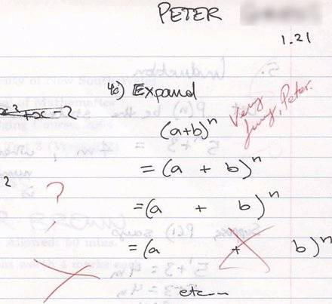

Slide 78
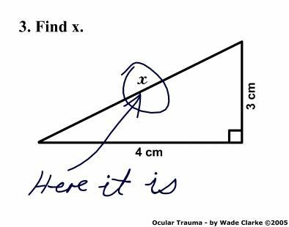

Slide 79
School Success: Only Academic?
Shoua is Hmong - little exposure to English outside of school
At the end of Kdg, she had more academic than social language - mostly school language (CALP)
  Knew colors
  Knew numbers 1-10
  Knew how to speak in question, imperative
    (I done, what I do now? I need glue, Write your name, cut paper).
    She knew what to do, just not what it meant (S -U-N = moon)

Slide 80
Shoua (Cont.)
Teacher provided many BICS opportunities (same as for ‘all’ children)
Teacher assumed Shoua could get BICS without direct instruction
Shoua became silenced and an outcast rather than a valued member of the class
Social Language Opportunities
  House keeping center (BICS) with doll along side other children
  Classroom sharing of photos (BICS)
  Show/tell (BICS) - Toy Story/Barbie

Slide 81
Difficult Aspects of Social Language
Respond to humor
Express anger in a socially appropriate way
Make polite requests
Carry on small talk
Use idiomatic speech
Understand multiple meaning words
To express yourself orally and in writing in socially and culturally appropriate ways

Slide 82
Váldes (1998)
Little opportunity for learning social language either in ESL classroom OR in regular English medium classrooms
The teachers and school had reductionist ideas about English needs of ELLs (all you need is school/classroom English)
Rigor demands that we fully develop English in our EB students
This means BICS + CALP + REGISTER + PRAGMATICS!!!

Slide 83
Respect
Language and literacy programs for EBs must understand that development of language is:
linguistic
cognitive
psychological
emotional

Slide 84
The acceptance of institutional racism
Larger society is NOT welcoming of ELLs in general and Mexican descent students in particular
Most messages teachers have learned about ELLs have a deficit paradigm
Creating a welcoming school culture is critical
Creating a relevant curriculum is also critical

Slide 85
Cultural Issues
Content of the Curriculum
How students are motivated or engaged
How teachers are taught to perceive students who may be different than them
School climate
Teacher Education
Notes:
We encourage future teachers to go into ‘hard to staff schools’ to teach ‘hard to teach’ students – this is in TEACHER EDUCATION – we encourage them to fight the good fight and work with ‘those kids’ - we tell them it’s a struggle but we have to work for social justice – we do NOT tell them it is an honor and a privlee to work with Mexican and other kids who have been taught to respect teachers and schools – we then send these 21 year olds out to schools to teach and they see the student on the next slide

Slide 86
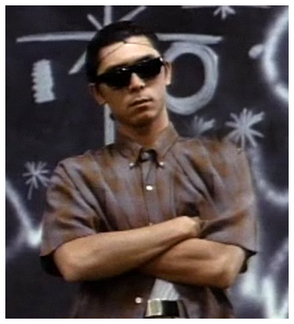
Notes:
Oh MY GOD – they were right in teacher ed – then they go to their first faculty meeting where the principals and veteran teachers reinforce what they learned in teacher ed – this is a ’tough’ school – we are ‘underperforming’ – we could apply for a federal grant BUT if we do that we have to fire the principal and ½ of the teachers – GOOD LUCK – teachers don’t last long here – our drop out rate is 50% - BUT we have ZERO TOLERANCE. You are not taught in teacher education to RESPECT or LOVE the students – You are taught to FEAR them and you buy into ZERO TOLERANCE – even as you teach to higher standards – for example “Dickens Christmas Carol”

Slide 87
An Example:
Register, Zero Tolerance and Culture
Register is NOT just the words you say, but the stance, intonation, body language, dress, you use.
All of the above when used as communication devices by Chicanos and 2nd-3rd generation Mexican-Americans is often found to be offensive in mainstream classes

Slide 88
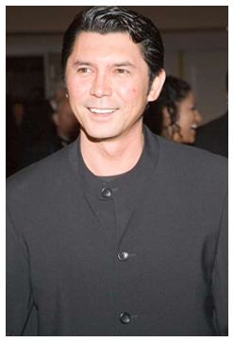

Slide 89
Montaño-Harmon (2000)
Do NOT eradicate informal register - add onto it
Have students keep double-entry journals (public voice/private voice)
Personal conduct - public conduct
Personal voice - public voice
Personal dress - public dress
Write it to a friend/write it to an adult who doesn’t know you.

Slide 90
Double Entry Journal
Private Voice
This stuff “sucks”
I’m pissed off
She went nuts
Public Voice
This material lacks academic
& social relevance
I’m emotionally distraught
I’m angry
She was visibly upset
She had a nervous breakdown

Slide 91
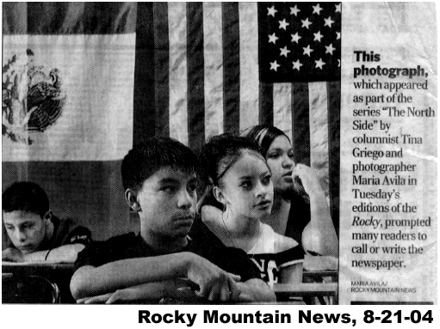

Slide 92
Cultural Revelant Teaching is not Easy
RESPONSE TO DOS BANDERAS
  “These two teachers should renounce their U.S. citizenship and move to Mexico where life is more in tune with their beliefs.”
  “Thank your luck stars you live in America. We have toilets that work.”
  “Most come here illegally, they suck off the system and won’t learn the language. Try to go shopping and ask a question of one of them. Blank stare.”
  “When in Rome do as the Romans do. And when in America do as the Americans do or go the hell home.”

Slide 93
Editor of the Rocky Mountain News
“I have never seen such an ugly side of our community….. If one of my Hispanic friends would
have told me this would happen, I wouldn’t have believed him. We need to do a lot of work on tolerance and respect.”

Slide 94
Cultural Respect?
“Our Mexican parents are good at making babies, they are just not good at raising them.”
“They don’t get any wetter than this.”
“Hold their welfare checks until they send their kids to school.”
“Ignorance is prevalent in our school, most of our parents are Mexican.”
Why aren’t we outraged?

Slide 95
Respect???
Colorado schools last Oct. were told to have the following plans:
  Inclement Weather
  Safety
  Fire
  Immigration Raids

Slide 96
Who are we accountable to?
Middle class schools we are accountable to the parents.
In poor schools we are accountable to the ‘state’ to ‘nclb’ but not the parents.
Who gets respect?

Slide 97
What to do?
Needs of Bilingual Learners need to move from the margins of educational policy and practice to the CENTER of the discourse and debate about school reform and improvement.
Need to develop a pedagogy for teaching Bilingual Learners that includes attention to developing bilingualism/biliteracy as well as English.
Need to critically examine and change reductionist frameworks.
We must learn to quit using words like misunderestimate and
QUIT misunderestimating the 5 million children like Manuel in
our schools.
We MUST be advocates and stand up against institutional racism.
Notes:
This is why you need to know and communicate with Juan Sepulveda, Thelma Melendez de Santa Ana, Barbara Medina and the Office for Civil Rights - the time is ripe for us to change - this is 2009 and NOT 1969 we have to do it!
Enough of one size fits all reading programs, millions of dollars on Prof Dev. That is meant for mono English kids with trainers who say ,’good teaching is good teaching.’ ENOUGH of school leaders who know nothing about 2nd language learning AND enough of policies that punish children and teachers

Slide 98
What happens on Monday?
If you were to talk to your teachers on Monday about this talk….
Which concepts would your teachers immediately reject?
Which do you need more information about?

