Slide 1

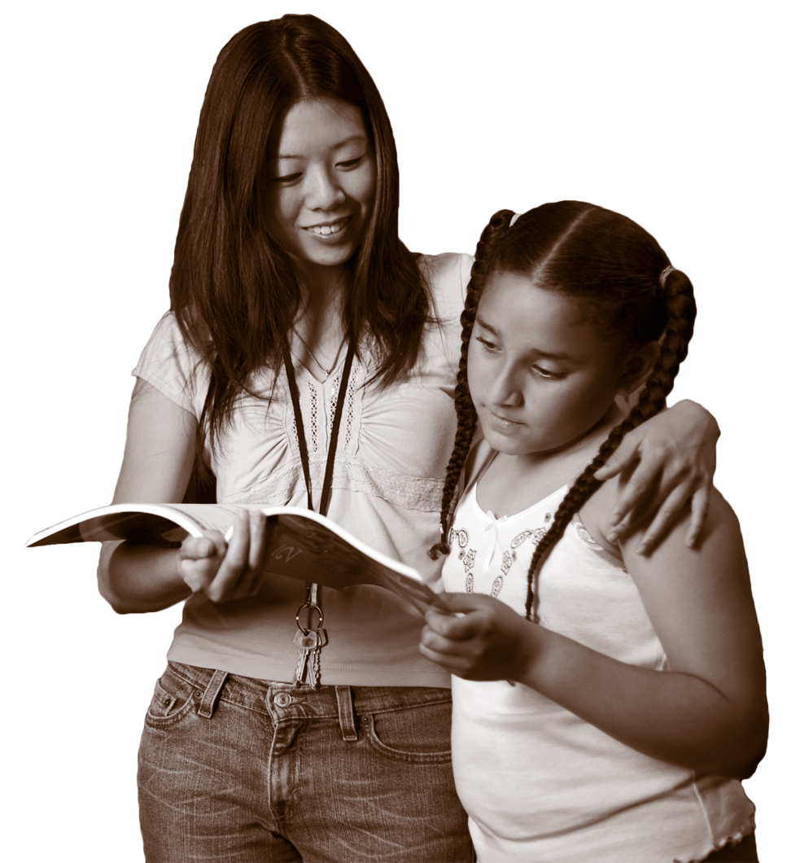

CENTER FOR STRENGTHENING THE TEACHING PROFESSION • 253-752-2082 • www.cstp-wa.org
Cultural Competence: Relationship
over management
St. Martin’s University
July 27, 2010
9:00 – 12:00
Culturally Responsive
These materials funded by the Grousemont Foundation.

Slide 2
Who is she? – make a guess
How old do you think she is?
Where do you think she is from?
What language(s) do you think she speaks?
What do you think her greatest accomplishment
has been?
What do you think her professional aspirations are?

Slide 3
Getting Started
Who’s here?
What are we doing today?

Slide 4
Objectives
Participants will develop a better understanding of their own personal cultural identity and how this impacts the way they develop classroom expectations.
Participants will develop a basic understanding of the variety of cultures in the region and how the cultural practices impact students’ responses to an education system.
Participants will leave with a toolkit of usable activities and materials.

Slide 5
Schedule for the day
1st hour
    Introductions
    Objectives
    Define terms
2nd hour
    Focus on Self
    What is my culture and worldview?
    How does this impact my decisions?
3rd hour
    Focus on others
    Who are the students I will be teaching?
    What are my attitudes about diversity?
    What do I need to know about my students and their cultures to be an effective teacher?
    How can I communicate and interact more effectively?

Slide 6
Modeling
Clear expectations
regular activity/movement
Reflection
Interaction/relationship
Options
Hooks
Greetings/gathering folks
Getting into groups

Slide 7
Session 1: Knowing yourself
Objective:
You will be able to define “culture”
and “cultural competence.”
You will learn about your personal culture and the culture of the community in which you live.

Slide 8
Activity 1: The Circle
Get into a circle.
For each statement you hear that is true, take a step forward and raise your hand.
Debrief: How could you use this in your classroom?
Write and reflect.

Slide 9
Define culture
Culture refers to the cumulative deposit of knowledge, experience, beliefs, values, attitudes, meanings, hierarchies, religion, notions of time, roles, spatial relations, concepts of the universe, and material objects and possessions acquired by a group of people in the course of generations through individual and group striving.

Slide 10
Cultural Competence is…
Knowing the community where the school is located
Understanding all people have a unique world view
Using curriculum that is respectful of and relevant to the cultures represented in its student body
Being alert to the ways that culture affects who we are
Placing the locus of responsibility on the professional and the institution
Examining systems, structures, policies and practices for their impact on all students and families

Slide 11
Cultural competence is not…
Good intentions
Cultural celebrations at designated times of the year, in designated ways
Kumbaya diversity
A list of stereotypes about what people from a particular cultural group do
Assumptions that all students from one culture operate in similar ways and have had similar experiences
The responsibility of children, their parents or the community
Color-blindness (treating everybody the same)
Simple tolerance

Slide 12
What does this mean for me as a teacher?
Developing cultural competence results in an ability to understand, communicate with, and effectively interact with people (students and families) across cultures.

Slide 13
Who am I in all of this?
Until you understand your own culture,
you cannot understand another’s.
Take out a scratch sheet of paper and respond to each of the questions you are about to see in the next slides.
You will be sharing 4 of your answers (your choice) with a group of people.

Slide 14
Personal Inventory A
What is your favorite song?
How do people in your family share important information and stories?
How do “outsiders” learn the “rules” of your family (e.g. – In our family we don’t share anything personal with outsiders; in our family we always wash our own dishes when we visit the grandparents, etc.)?
Describe the common belief/faith system (or lack thereof) that is practiced by members of your family.

Slide 15
Personal Inventory B
Describe your family’s favorite way to spend free-time/vacation time.
If your house was burning down, what 3 items would you try to save? Why?
What activities made you happiest as a child?
What experience(s) made you sad or angry?
Think about your childhood. Describe the most common ways adults in your life communicated in public?
Describe how members of your family deal with conflict.

Slide 16
Activity 3: Breaking into teams
Get yourself into order by birth date without talking or making any noise.
Presenter will break you into teams of 3 – 4.

Slide 17
Small group share-out
Select 4 responses from the Personal Inventory to share with the other participants at your table (each person determine which four responses they are willing to share).
Each member share name and ONE response quickly with whole group.
Move around the table until everyone has shared 4.

Slide 18
Return to Seat

Slide 19
Debrief
Think-pair-share
  How could you use this in a content area or for professional development?
Write and reflect.

Slide 20
Activity 4: Walk it out
As you hear the statements, give yourself a point for each that is true for you.
Total your points at the end of the activity and wait for further instructions
Debrief – reflect, discuss, write
Share 40 Developmental Assets

Slide 21
Session 2: Knowing those
around you
Objective:
You will understand how your culture “colors” your perceptions of others.
You will be able to identify the dominant culture of the students in your classroom.
You will learn the importance of valuing diversity
You will learn to identify critical elements of culture
You will be exposed to skills that will assist you in teaching students from diverse cultural backgrounds

Slide 22
Using Media
There is much that can be learned by watching the experiences and responses of others.

Slide 23
How early does race matter?
Do children still see in black and white?
  A Girl Like Me – Kiri Davis, 2005
  http://www.mediathatmattersfest.org/watch/6/

Slide 24
Race and Data
CEDARS
Requires racial self-identification
If no self-identification by student or parent/family,
teachers/school staff are REQUIRED to visually identify the student’s race
COULD YOU IDENTIFY EACH OF YOUR STUDENT’S RACE?

Slide 25
What is the impact of race?
  What’s Race Got To Do With It
  http://www.pbs.org/race/005_MeMyRaceAndI/005_00-home.htm

Slide 26
Does race impact achievement or is it just poverty?
What is the problem?

Slide 27
Washington State 10 Year Student Picture
Group | 1998-99 | 2009-10 | Net Change
All # | 999,616 | 1,040,750 | + 41,134
White | 759,708 (76%) | 672,350 (64.8%) | -87,358 (-11.2%)
Am Indian/Alaska | 27,989 (2.8%) | 27,363 (2.6%) | -626 (-0.2%)
Latino | 90,965 (9.1%) | 158,612 (15.3%) | +67,647 (+6.2%)
African American | 50,980 (5.1%) | 56,790 (5.5%) | +5,810 (+0.4%)
Asian Am/Pacific Is | 70,973 (7.1%) | 89,231 (8.6%) | +18,258 (1.5%)
Bilingual/ELL | 5.1% | 8% | +2.9%

Slide 28
If nothing changes
4th Grade | African American | Latino | Native American
Reading | 2022 (12yrs) | 2022 (12yrs) | 2029 (19yrs)
Math | 2042 (32yrs) | 2050 (40yrs) | 2049 (39yrs)
10th Grade | African American | Latino | Native American
Reading | 2017 (7yrs) | 2017 (7yrs) | 2018 (8yrs)
Math | 2064 (54yrs) | 2056 (46yrs) | 2058 (48yrs)

Slide 29
High school graduation rates 2007-08

Slide 30
What is the impact
of race
and/or culture
on your students?
Let’s talk about YOUR kids!

Slide 31
Personal Brainstorm:
When you think about developing classroom expectations, what are the 3 most important expectations?
What happens if these expectations are in conflict with your students’ expectations or with your building’s expectations?

Slide 32
Group brainstorm…
As a table group, have a conversation about the following:
  When your expectations and the school’s expectations are different, what do you think happens to kids?
  How can you impact change in this area?

Slide 33
Taking it a step further
  Respond based on your experiences as a student:
  Who were the students who were most successful in your school?
  Who were the students who experience the greatest challenges?
  How was culture celebrated/ignored at your school?
  Describe the behaviors of students who were in conflict with the practices/expectations of your school building.

Slide 34
What have you learned about these communities?
What are the ways students/youth interact with adults/elders?
What are the most effective methods of communicating
with parents?
Who are the community leaders?
What important traditions/holidays need to be recognized/acknowledged?
Anything else?

Slide 35
How can you learn more?
Find an adult/parent with whom you can have coffee 1 – 2 times per month.
Visit ethnic restaurants in your community and take notes about:
  How families interact.
  How adults and children share space.
  Noise levels.
  What you hear when you close your eyes.
  Foods you try that you have never eaten before.
Visit religious sites/institutions where your students worship.
Commit to attending cultural events in the community

Slide 36
Debrief/
wrap-up
Questions and Answers

Slide 37
Questions and
Answers

Slide 38
Free Trainings
Communicating with parents from diverse backgrounds –
CISL and OEO
Developing authentic school- family –
community partnerships – CISL
Understanding Washington State’s achievement gap – CISL
Developing a strategic plan to address the achievement gap - CISL
Understanding Civil Rights – OSPI and WEA
Cultural Competence for educators– CISL and WEA
Creating culturally competent systems - OSPI
Cultural competence – build relationships with your families
and community!!!

Slide 39
Websites with FREE resources
www.yourlearningcenter.org (Center for the Improvement of Student Learning) – best practices research, translated materials, achievement gap studies, free training videos, interviews, power points, upcoming statewide events, Q & A, etc.
www.governor.wa.gov/oeo/ (Office of the Education Ombudsman) – information for parents, upcoming trainings;
www.cstp-wa.org (Center for the Strengthening of the Teaching Profession) – Research on teaching practice, state ELL study, teacher advocacy trainings;
www.edtrust.org (Education Trust) – national best practice models and data on addressing the achievement gap, real stories!, upcoming conferences;
www.teachingtolerance.org – teaching strategies to address cultural awareness student-to-student and teacher-to-student, lesson plans, activity grants, free supplies
www.montgomeryschools.md.org – sample district strategic plan to address the achievement gap (this district has done more than any other in the nation to address the achievement gap) – MUST CHECK OUT!!!

Slide 40
CISL resources
Website: www.yourlearningcenter.org
  Achievement Gap Oversight and Accountability Committee recommendations and agendas
  Free training/support materials
        Achievement gap
        Cultural competence
        Authentic family/community/school partnerships
Contact information:
  cisl@k12.wa.us
  (360) 725 - 6503

Slide 41
Contact us:
Erin Jones – erin.jones@k12.wa.us
Maria Flores – maria.flores@k12.wa.us
Center for the Improvement of Student Learning
Assistant: Jessica Cole – (360) 725 - 6503
cisl@k12.wa.us

