Slide 1

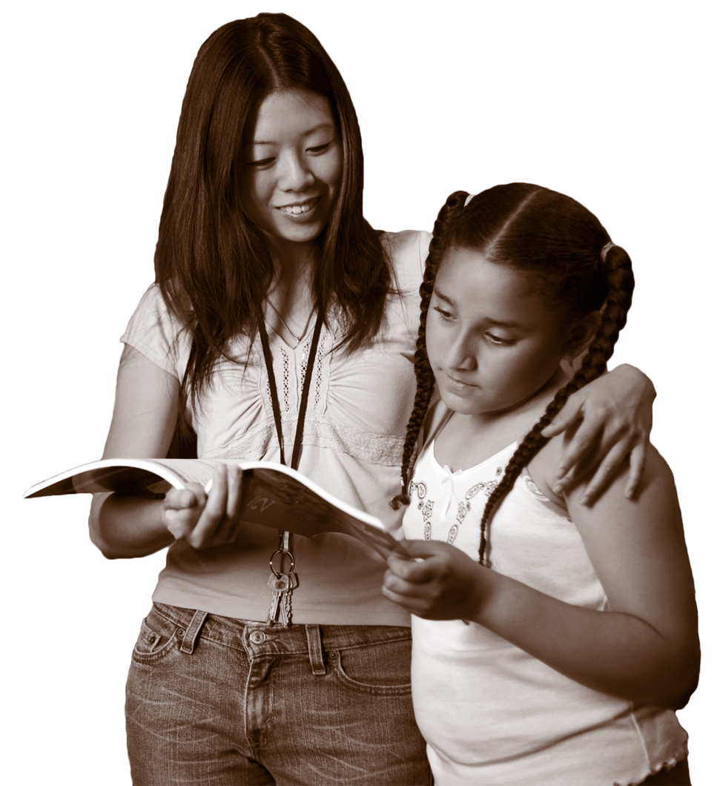

CENTER FOR STRENGTHENING THE TEACHING PROFESSION • 253-752-2082 • www.cstp-wa.org
Culture
Culturally Responsive
These materials funded by the Grousemont Foundation.

Slide 2
Culture
“Culture is who we are and who we are becoming. It is the food we put on the table, the way we cook it, the utensils with which we eat it, the relations between the people who sit at the table and the people who cook and serve, what is done with the leftovers, what is discussed during the meal, what music, dancing, poetry or theatre accompany it, and the social and spiritual values of those present – for when we say culture, we include visions, dreams, and aspirations of humanity.”
From “The Power of the Word: Culture, Censorship and Voice.” Women’s World, 1995.

Slide 3
Culture, Another Definition
The way of life is organized within an identifiable community or group.
This includes the ways that community use language, interact with one another, take turns to talk, relate to time and space, and approach learning.
There are group patterns that exist, which reflect the standards or norms used by community members to make sense of the world.
(Villegas and Lucas, 2002)

Slide 4
Identity: Race, Culture, Ethnicity
What’s the Difference?
Race Identity
Gender Identity
Nationality Identity
Religion Identity
Ethnic Identity
Class Identity
Age Identity
How do you see yourself?
How do others see you?

Slide 5
Culture
Consider and reflect:
  What is the culture of your School District?
  What is the culture of your building or department?
  How might students’ and families’ cultures conflict with the culture of school?

Slide 6
Are These Cultural Determinations?
    Greetings
Eye contact
Proximity
Conversations
(when to interrupt)
Dr. Sharroky Hollie, Executive Director of the Center for Culturally Responsive Teaching and Learning

Slide 7
Think about the various students and groups
in your classes.
What are some of the impediments they have
to learning?
How would you address these in your classes?

