Slide 1
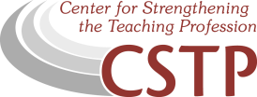
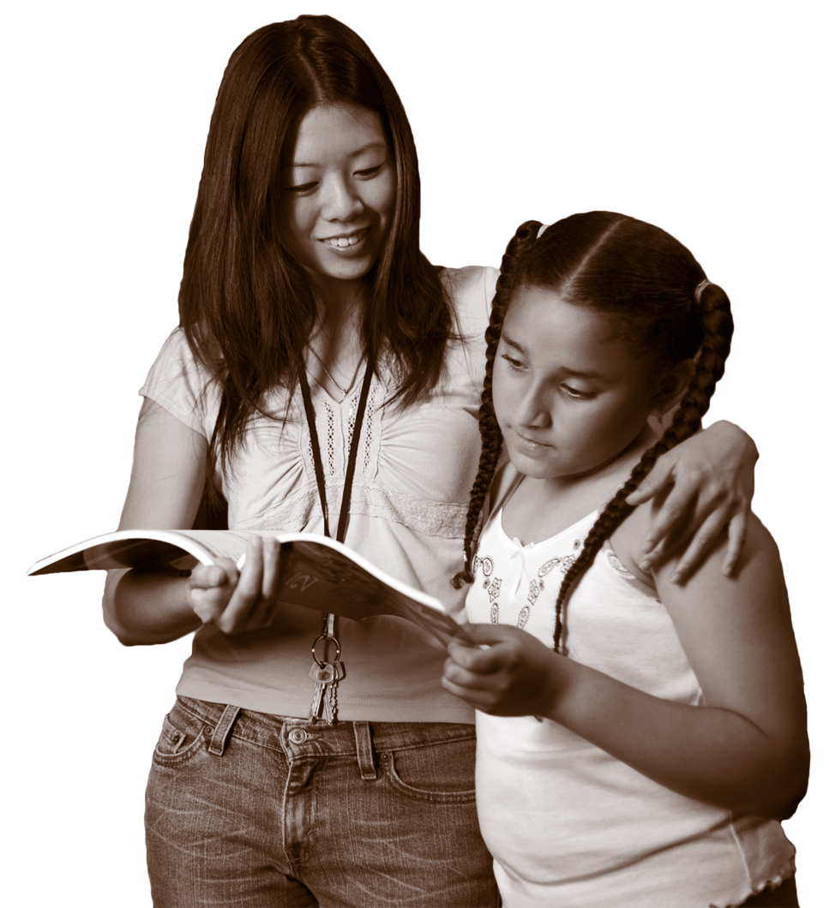

CENTER FOR STRENGTHENING THE TEACHING PROFESSION • 253-752-2082 • www.cstp-wa.org
Culturally
and Linguistacally Responsive Teaching
Culturally Responsive
These materials funded by the Grousemont Foundation.

Slide 2
Culturally and Linguistically Responsive Teaching
Geneva Gay, in Culturally Responsive Teaching – Theory, Practice and Pedagogy (2004), defines culturally responsive pedagogy as the use of cultural knowledge, prior experiences, frames of reference, and performance styles of ethnically diverse students to make learning encounters more relevant to and effective for them. It teaches to and through the strengths of these students. It is culturally validating and affirming.
More simply, CLR validates and affirms the home language and culture of students through the use of responsive instructional strategies, which act as bridges or enablers to acceptance, achievement, and empowerment in academic settings and mainstream culture at large.
Sharroky Hollie. Pearson Longman advertisement, 2008.

Slide 3
Culturally Responsive Teachers Must:
Acknowledge the legitimacy of cultural heritage.
Use a wide variety of instructional strategies.
Teach students how to praise their own and others’
cultural heritages
Dr. Sharroky Hollie, Executive Director of the Center for Culturally Responsive Teaching and Learning

Slide 4
Tenets of Culturally and Linguistically Responsive (CLR) Instruction
Affirm
Validate
Socialize
Movement
Holistic
Spontaneous
Challenge
Structure
Engagement
Personal
Ritual
Contextual
Dr. Sharroky Hollie, Executive Director of the Center for Culturally Responsive Teaching and Learning

Slide 5
Code Switching
In simple terms, it is the act of moving between languages or cultural behaviors based upon the context of the situation.

