Slide 1

TPEP Evaluation System Toolkit
April 30th 2019
Notes:
Note to Facilitator – See Facilitator Directions on Agenda Document.

Slide 2
WELCOME!
Sue Anderson, Educator Effectiveness @OSPI
Terese Emry
Greta Bornemann

Slide 3
Today’s Agenda
Learning Target
Welcome
TPEP Update
Toolkit Introduction
Digging into the Toolkit
District Team Huddle
Closing
I have been introduced to the TPEP “Toolkit” and potential leverage points to enhance educator effectiveness in our classrooms and schools.

Slide 4

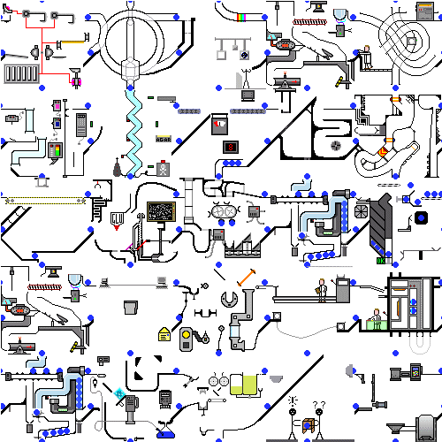
Complete this statement:
“Leading my school or district’s evaluation system is like this image because . . .”
Complete this statement:
“Leading my school or district’s evaluation system is like this image because . . .”

Slide 5
Who’s in the room?
At your table, introduce yourself (name, district, role) and respond to the prompt. EACH TEAM CHOOSES one response to share with the room.
Leading my school or district’s evaluation system is like this image because . . .

Slide 6
TPEP Update

Slide 7
iGrant 664 - Claim! Enroll! Attend!
Student Perception Surveys
Calibration Videos
Students with Disabilities
For the good of the order…
            NBCTs and TPEP
            WAC changes
            CEL 3.0

Slide 8
CONFER WITH YOUR TEAM…. WHICH STATEMENT IS TRUE FOR YOUR DISTRICT?
    Framework is your roadmap for all PD and instructional improvement
    Framework guides growth conversations
    Framework comes out for evaluation

Slide 9
WHAT ABOUT THIS STATEMENT?
    Your district doesn’t use all of its 664 grant funding
    Your district uses all of its 664 to meet state requirements for TPEP
    Your district invests significant local dollars beyond 664

Slide 10
Growing Teacher and Principal Practice:
An Evaluation System Toolkit for Districts

Slide 11
Purpose of the Toolkit
Provide a “touchstone” for best practices in educator growth and evaluation.
Offer a “third point” for discussions about effective and ineffective practices, and for future planning.

Slide 12
Structure of the Toolkit
Four elements:
  District Leadership
  Professional Learning – Teachers
  Professional Learning – Principals and Principal Evaluators
  Foundational and Routine Procedures
For each element:
  Description
  Key indicators of quality practice
  Descriptors for the indicators, with an opportunity to self-assess
  Ideas and examples
  Vignettes of problematic practice and discussion questions
  Resources

Slide 13
For our work today:
Where are our district practices strong? What evidence do we have?
Where do we need to concentrate efforts to improve our district practices? How to best prioritize?
Who else needs to be in this conversation?
What additional ideas do you have for vignettes, resources, etc.?

Slide 14
  Let’s look at Element 4:
  Foundational and Routine Procedures Pages 20-23
Description
Key indicators of quality practice
Descriptors for the indicators, with an opportunity to self-assess
Ideas and examples
Vignettes of problematic practice and discussion questions
Resources

Slide 15
Foundational and Routine Procedures
Five minutes silent reading time, and then discuss at your tables:
* Where are our district practices strong? What evidence do we have?
*Where do we need to concentrate efforts to improve our district practices? How to best prioritize?
*Who else needs to be in this conversation?
*What additional ideas do you have for vignettes, resources,
etc?

Slide 16
In your discussion…
Please make sure all voices are heard.
Note anything you think needs attention on sticky notes, with a page reference so we can take a look.

Slide 17
Deeper Dive into the TPEP “Toolkit”
Participants choose to learn more about two of the other elements - 30 minutes each round
“Team Huddle” to share insights

Slide 18
Element 1: District Leadership
  pages 3-6
Element 2: Professional Learning for Teachers
  pages 7-13
Element 3: Professional Learning for Principals and Principal Evaluators
  pages 14-19

Slide 19
Deeper Dive
Five minutes silent reading time, and then discuss at your tables:
* Where are our district practices strong? What evidence do we have?
*Where do we need to concentrate efforts to improve our district practices? How to best prioritize?
*Who else needs to be in this conversation?
*What additional ideas do you have for vignettes, resources, etc.?
Notes:
Have noticed especially when there are differences in positional power, it can make it challenging for everyone to believe they have a voice. You’ll get the most out of this as a district team if people in different roles can hear each other.

Slide 20
Team Huddle:
What idea(s) will be useful to remember and consider?
What are our next steps?
What questions do we have?
How can ESD and OSPI be helpful?

Slide 21
Access the most recent version of the Toolkit at this link:
http://cstp-wa.org/cstp2013/wp-content/uploads/2018/02/EvaluationSystemToolkitDRAFTFeb18.pdf
CSTP - Resources

Slide 22
Send suggestions and comments to
Sue.Anderson@k12.wa.us
Thank you!

