Slide 1

TPEP Evaluation System Toolkit
FEBRUARY 27, 2019
Notes:
Note to Facilitator – See Facilitator Directions on Agenda Document.

Slide 2
WELCOME!
Sue Anderson, Educator Effectiveness @OSPI
Jeanne Harmon, OSPI Contractor
Joy Lansdowne, ESD 101

Slide 3
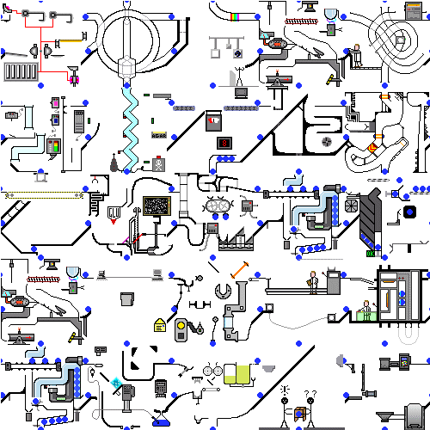
Complete this statement:
“Leading my school or district’s evaluation system is like this image because . . .”

Slide 4
Who’s in the room?
District Rep shares district, roles at the table and one response to this prompt…
Leading my school or district’s evaluation system is like this image because . . .

Slide 5
TPEP Update

Slide 6
INSERT RELEVANT TOPICS FOR THE UPDATE

Slide 7
Today’s Agenda
Learning Target
Welcome
TPEP Update
Toolkit Introduction
Digging into the Toolkit
District Team Huddle
Closing
I have been introduced to the TPEP “Toolkit” and potential leverage points to enhance educator effectiveness in our classrooms and schools.

Slide 8
Growing Teacher and Principal Practice:
An Evaluation System Toolkit for Districts

Slide 9
Think and talk…
Look at these two continua.... Discuss where your to locate your district on each:
  Instructional framework integration
  Resources invested

Slide 10
Purpose of the Toolkit
Provide a “touchstone” for best practices in educator growth and evaluation.
Offer a “third point” for discussions about effective and ineffective practices, and for future planning.

Slide 11
Structure of the Toolkit
Four elements:
  District Leadership
  Professional Learning – Teachers
  Professional Learning – Principals and Principal Evaluators
  Foundational and Routine Procedures
For each element:
  Description
  Key indicators of quality practice
  Descriptors for the indicators, with an opportunity to self-assess
  Ideas and examples
  Vignettes of problematic practice and discussion questions
  Resources

Slide 12
For our work today:
Where are our district practices strong? What evidence do we have?
Where do we need to concentrate efforts to improve our district practices? How to best prioritize?
Who else needs to be in this conversation?
What additional ideas do you have for vignettes, resources, etc.?

Slide 13
  Lets look at Element 4:
  Foundational and Routine Procedures Pages 19-22
Description
Key indicators of quality practice
Descriptors for the indicators, with an opportunity to self-assess
Ideas and examples
Vignettes of problematic practice and discussion questions
Resources

Slide 14
Foundational and Routine Procedures
Five minutes silent reading time, and then discuss at your tables:
* Where are our district practices strong? What evidence do we have?
*Where do we need to concentrate efforts to improve our district practices? How to best prioritize?
*Who else needs to be in this conversation?
*What additional ideas do you have for vignettes, resources, etc.?

Slide 15
Deeper Dive into the TPEP “Toolkit”
Participants choose to learn more about two of the other elements – one role alike, one “wild card”
“Team Huddle” to share insights

Slide 16
Element 1: District Leadership
  pages 3-6
Element 2: Professional Learning for Teachers
  pages 7-12
Element 3: Professional Learning for Principals and Principal Evaluators
  pages 13-18

Slide 17
Deeper Dive
Five minutes silent reading time, and then discuss at your tables:
* Where are our district practices strong? What evidence do we have?
*Where do we need to concentrate efforts to improve our district practices? How to best prioritize?
*Who else needs to be in this conversation?
*What additional ideas do you have for vignettes, resources, etc.?

Slide 18
Team Huddle:
What idea(s) will be useful to remember and consider?
What are our next steps?
What questions do we have?
How can ESD and OSPI be helpful?

Slide 19
Access the most recent version of the Toolkit at this link:
http://cstp-wa.org/cstp2013/wp-content/uploads/2018/02/EvaluationSystemToolkitDRAFTFeb18.pdf
CSTP - Resources

Slide 20
Close the Day

